Slide 1
Maths Sessions for Parents/Carers
April 2017

Slide 2
Aims of the Session
How do we deliver the aims of the National Curriculum, 2014 in relation to Maths?
Recognise the importance of a growth mindset.
Explain how we teach Maths at Thomas Willingale – the CPA approach.
What do we mean by Maths Mastery?
Have a look at the written methods your children will be learning – our calculation policy. Updated version will be on our website soon!
A better understanding of all of this will help you to support your child at home.

Slide 3

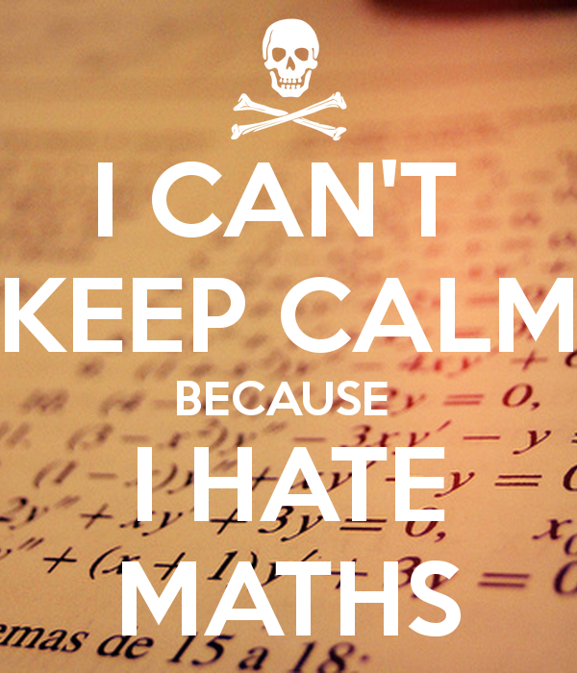
Maths at school…
Did you love
or loathe maths?!

Slide 4
Growth Mindset
What is this?
Can having a fixed mindset affect my child? Yes, a positive outlook towards learning is vital.
https://www.youtube.com/watch?v=s4xqzgBy-lM
I can’t do it…yet!

Slide 5
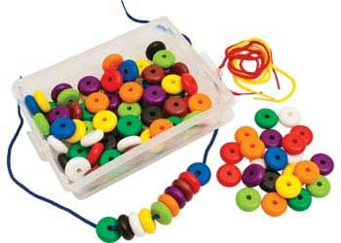
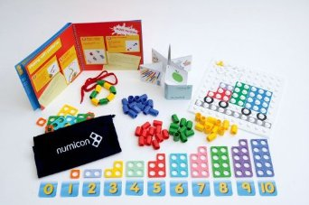
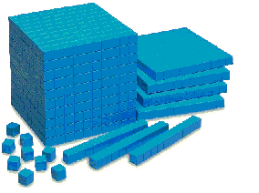
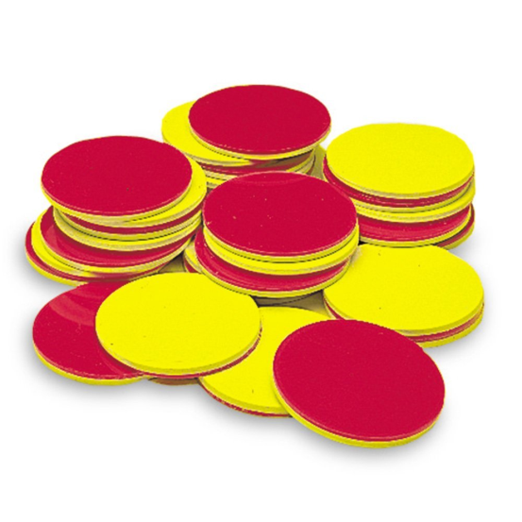
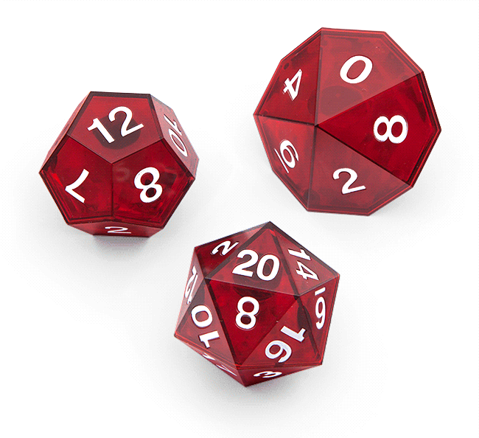
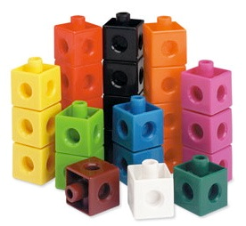
CPA – Bruner 1966.
C = concrete – the doing stage - examples of maths equipment are on a table.

Slide 6
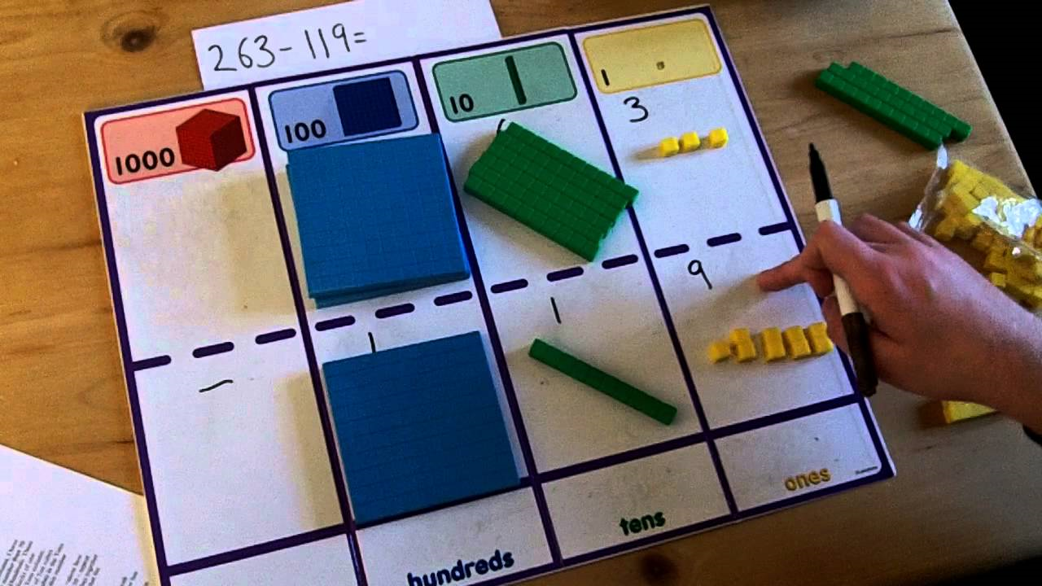

Slide 7
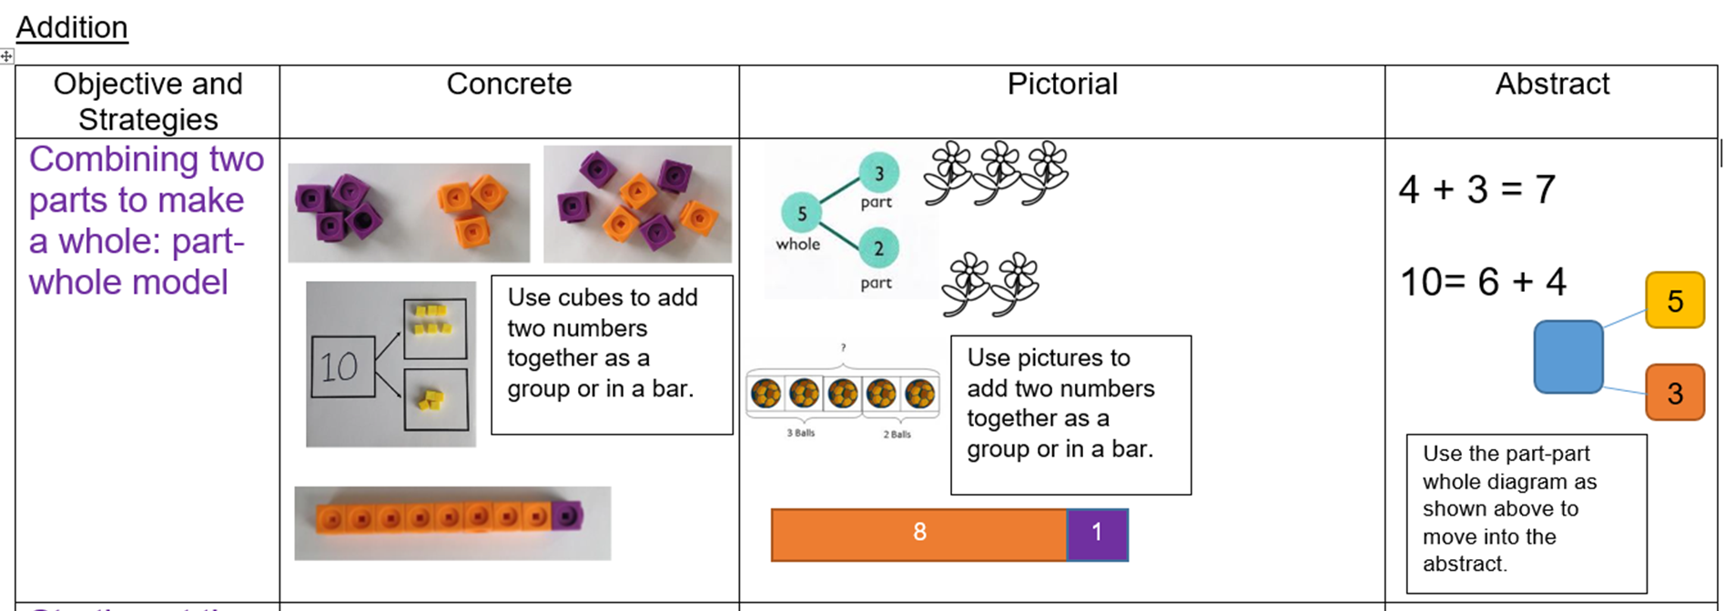
CPA
P = pictorial - a visual representation.
This is the seeing stage. Let’s consider 3 + 2 = 5

Slide 8
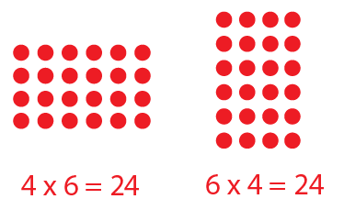
Arrays
An arrangement of objects, pictures, or numbers in columns and rows is called an array. Arrays are useful representations of multiplication concepts.

Slide 9
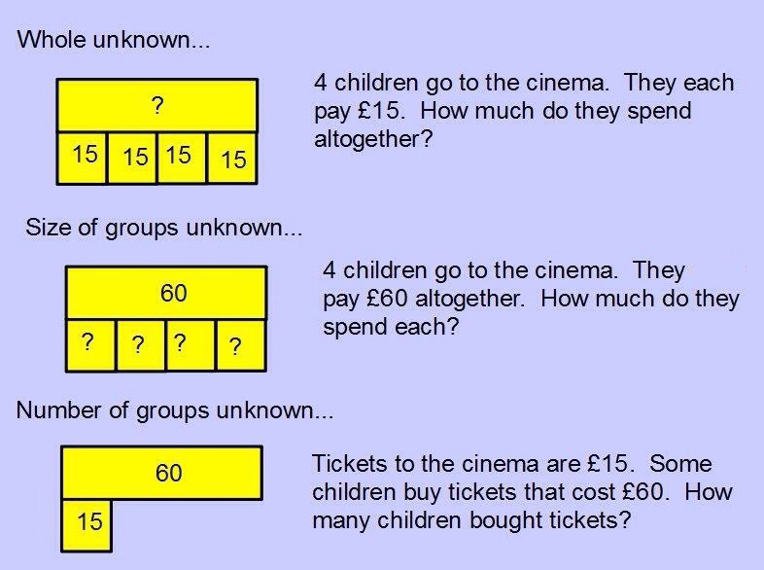
Bar modelling

Slide 10
CPA
A = abstract
Abstract is the “symbolic” stage, where children are able to use abstract symbols to model problems (Hauser).
Only once a child has demonstrated that they have a solid understanding of the “concrete” and “pictorial” representations of the problem, can the teacher introduce the more “abstract” concept, such as mathematical symbols; for example +, –, x, / to indicate addition, subtraction, multiplication, or division.
Although I’ve presented CPA as three distinct stages, a skilled teacher will go back and forth between each representation to reinforce concepts.

Slide 11
Around since the 1960s!
Ofsted recognise the CPA approach, and the lead inspector for mathematics, Jane Jones, has specifically referenced the use of manipulatives and the development of reasoning as crucial to good mathematical development in all our pupils. It is the ability to transfer understanding between resource and action, representation, symbol, language, real life experience and application that truly denotes mastery of learning. The ‘CPA’ approach captures and models this with pupils.

Slide 12
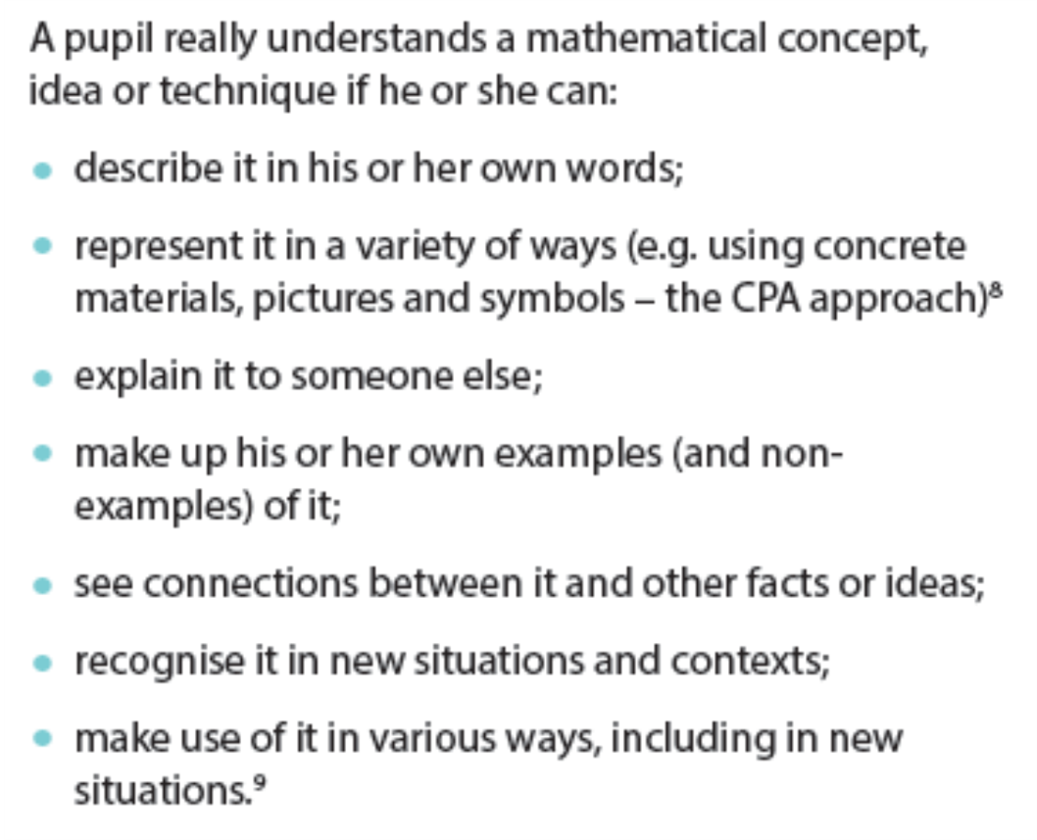
Maths Mastery

Slide 13
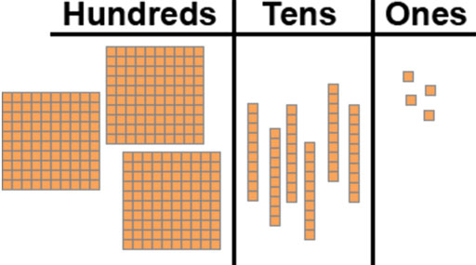
Written Methods
Place Value – how did you learn it?

Slide 14
Multiplication and Division
Multiplication is repeated addition, division is repeated subtraction
Doubling, halving, partitioning, and multiplying by 10, 100, 1000 are essential mental strategies
3x4=12 leads to 4x3, 12÷3, 12÷4, 6x4, etc, 30x4, 300x4, 120÷4 etc
Children need to see facts as sets of numbers that relate to each other

Slide 15
How can you help?
Our calculation policy will be updated and on our website.
Talk about Maths, use any opportunity to mention Maths – shopping, tell the time etc.
Would you like to come in to your child’s class and help with number bonds etc?
Websites:
www.youcubed.co.uk
www.Thirdspacelearning.com
www.oxfordowl.co.uk

Slide 16

Questions…

