Slide 1
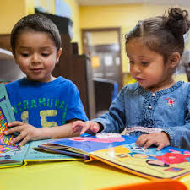
Phonics and Reading
in Reception

Slide 2

Phonics
At TWS we use the ‘Phonics Bug’ phonic scheme to support our phonics learning.
The children have been practising their listening skills in preparation for hearing letter sounds.
The children will be learning the sound each letter makes to support their reading and writing.
The children have a phonics lesson twice a day which includes pencil grip and letter formation.

Slide 3
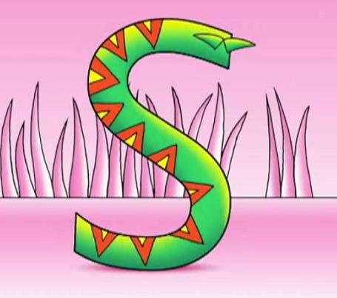
How phonics is taught in class
Demo lesson
https://www.activelearnprimary.co.uk/planning#bugclub_phonics

Slide 4
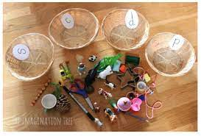
Phonics at home
Look for objects beginning with a particular letter sound around the home.
Sort objects by their initial letter sound.
Play action games saying the action in ‘sound talk’ to support your child’s blending skills.
Eg. Can you:
c-l-a-p your hands,
j-u-m-p,
h-o-p,
t-a-p your knees etc.

Slide 5

Supporting your child with phonics and reading
What next?
In class each week your child will be learning the sounds that individual letters make.
We also introduce the children to tricky words – these are words that have to be learnt by sight.
Please practice reading and writing the letter names, sounds and words.
Play lots of games using the letters sounds, games like ‘I spy’ are great for helping with this.

Slide 6

Reading in Reception
Children read 1:1 with their Class Teacher or Teaching Assistant once or twice a week.
Shared reading and reading for enjoyment as a class everyday.
Reading at home 4 times a week.
School library books.
Notes:
We support children from their individual starting points in all aspects of their learning and this is no different with reading. Use bug club to supplment your child’s reading in print. Stocked book shelves by Class teacher – target children's ability with reading. Lots of comprehension activities to support these skills after finishing books.

Slide 7
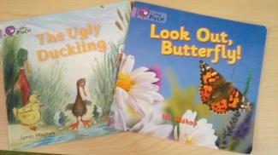
How we introduce reading
Picture books –These are books with no text. These encourage children to use pictures as clues to tell the story and builds on their communication and story language and story sequencing.
“The more you read aloud, the better you get to know the story,
the more it can be improved.”
Pie Corbett, 2006
Notes:
Now you have done your bit, how to go about helping them when they read! Lilac books are great – fantastic way to begin on the path to being a reader, develop story telling skills, use pictures as clues, encourage language use and development. Builds confidence and self esteem – I’m a reader! Lilac books on your tables – work in pairs trying to use the pictures to tell the story/information. Great precursor that allows chidlren to build those good solid reading skills and habits.

Slide 8
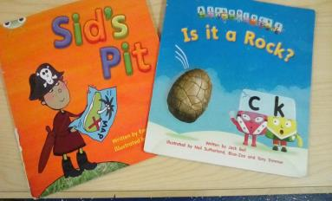
Reading at home
What next?
Banded books-These books are decodable. They allow children to practice segmenting and blending. The books will match the letter sounds your child is learning in class.
Notes:
We support children from their individual starting points in all aspects of their learning and this is no different with reading. Use bug club to supplment your child’s reading in print. Stocked book shelves by Class teacher – target children's ability with reading. Lots of comprehension activities to support these skills after finishing books.Demo reading using phonics
Ask parents to use photocopied example of red book to sound out the text with others on their table. http://www.oxfordowl.co.uk/api/courses/27/digital_books/1285.html?engine=http%3A%2F%2Foup-oxed-pop-production-assets.s3.amazonaws.com%2Febook-engine%2F
http://www.oxfordowl.co.uk/for-school/ebook-collection?view=default&query=&type=book&age_group=Age+4-5&book_band=&book_type=&series=#

Slide 9
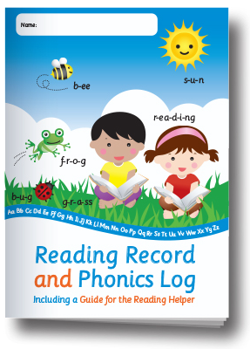
Reading diaries
Recording your child’s reading
It is essential that you sign and date your child’s reading record after each read.
This allows us to know when your child’s book needs changing and to monitor their progress.
We have class reward charts to encourage your child to read at home.
Please feel free to write a comment if you so wish.
Hints and tips sections.
Notes:
We support children from their individual starting points in all aspects of their learning and this is no different with reading. Use bug club to supplment your child’s reading in print. Stocked book shelves by Class teacher – target children's ability with reading. Lots of comprehension activities to support these skills after finishing books.Demo reading using phonics
Ask parents to use photocopied example of red book to sound out the text with others on their table. http://www.oxfordowl.co.uk/api/courses/27/digital_books/1285.html?engine=http%3A%2F%2Foup-oxed-pop-production-assets.s3.amazonaws.com%2Febook-engine%2F
http://www.oxfordowl.co.uk/for-school/ebook-collection?view=default&query=&type=book&age_group=Age+4-5&book_band=&book_type=&series=#

Slide 10
Online learning
Books
Your child will be allocated a small number of
books each week to support their reading and
phonics learning. Don’t forget to click on the bug!
Games
On occasion there will also be a short game for your child to play which helps assess how well they have understood the learning.
Notes:
We support children from their individual starting points in all aspects of their learning and this is no different with reading. Use bug club to supplment your child’s reading in print. Stocked book shelves by Class teacher – target children's ability with reading. Lots of comprehension activities to support these skills after finishing books.Demo reading using phonics
Ask parents to use photocopied example of red book to sound out the text with others on their table. http://www.oxfordowl.co.uk/api/courses/27/digital_books/1285.html?engine=http%3A%2F%2Foup-oxed-pop-production-assets.s3.amazonaws.com%2Febook-engine%2F
http://www.oxfordowl.co.uk/for-school/ebook-collection?view=default&query=&type=book&age_group=Age+4-5&book_band=&book_type=&series=#

Slide 11
Why read a book more than once?
To check understanding – encourage use of picture clues to help understanding, also show your child how you might be able to predict the meaning from other word clues.
Use question prompts to help deepen your child’s understanding and support their reading development.
Has your child ever asked to have the same book read over and over again? Reading for enjoyment, story sequencing and story language.
Many of the home reading books have questions or activities to support your child’s reading comprehension.
In school, during shared reading and 1:1 reading we will use reading vipers to support the children’s reading skills.

Slide 12
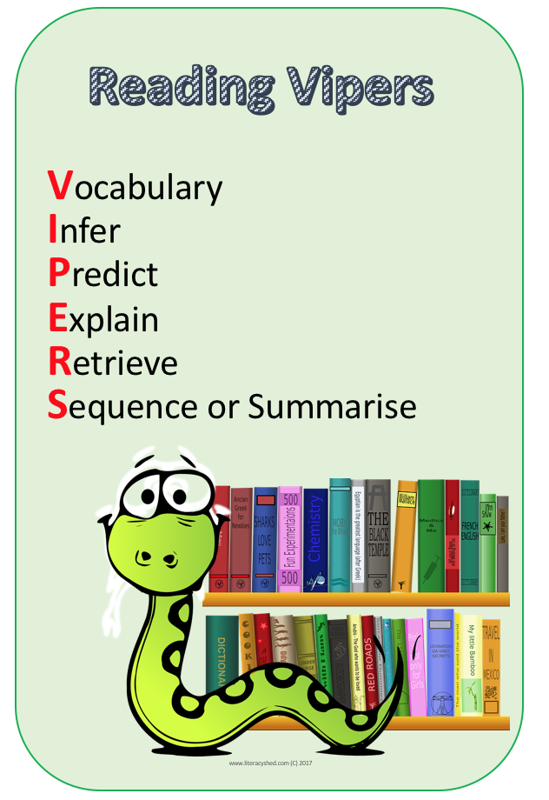

Slide 13

Extra tips
Turn off the TV and limit screen time on other devices.
Read when you are out and about – road signs, timetables, billboards, menus, recipes.
Play games.
Sing songs and nursery rhymes.
Read and recite poetry / tongue twisters.
Look at Tapestry together and listen to your child as they tell you about their school activities.
TALK TALK TALK!

Slide 14
Other information and reminders
After half term we will be starting our Family Fridays! You will be able to come into the class rooms with your child to read and share a story.
Tapestry – access, like our posts, homework, your posts
Class page – this is updated regularly with information about the children’s week, timetable and curriculum overviews.
PE days – Monday and Thursdays, remove earrings, children come in their PE kit.
Water bottles – labelled and only water please.
Clothing – please label clearly.
Welly boots – Have you brought some in?

Slide 15
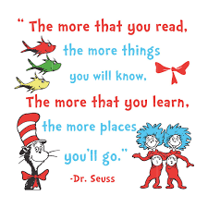
Any questions?

