Slide 1


Welcome!
Year 2
Parent’s Meeting

Slide 2
Welcome
Miss Higgs –
Willow Class Teacher
Mrs Ayaz–
Juniper Class Teacher
Notes:
Briefly introduce ourselves. Name, class, how long we’ve been here etc

Slide 3
The Curriculum
Your child will be taught:
English (reading, writing, phonics, SPaG),
Maths,
Science,
History,
Geography,
Computing,
Music,
RE,
PSHE,
PE,
Art and D&T
French lessons.
We will teach all of the subjects in a cross curricular way.

Slide 4
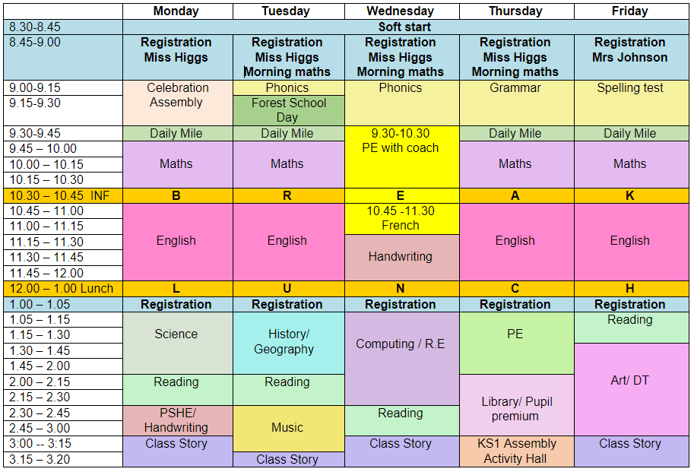
A Typical Day
Notes:
Ria talk through hers – transition from rec to yr 1
Kim- Lunhctimes / Playtime activities/ buddy bench/ rubbish in boxes
Others on website.

Slide 5
What is needed?
Labelled School uniform
Book Bag – reading book and record in school everyday.
PE days are Wednesday and Thursday (no earrings and long hair tied up.)
Labelled water bottle
Appropriate forest school wear, every other Tuesday
Wellies to remain in school for opal play
Notes:
Kit sent home half termly

Slide 6
Year 2 Topics
Great and Ghastly Events
Australian Adventures
Field to Fork
Marvellous Mechanisms
Our knowledge organisers go into more detail about what your children will be learning throughout each topic. These can be found on the Year 2 class pages on the website.
Notes:
Kim speak through topics.

Slide 7
Homework
Maths and English homework will be set on a Thursday.
This will need to be returned on the following Tuesday.

Slide 8
Reading
This year we will continue with our reading approach. This has seen an improvement in children's fluency when reading as well as their vocabulary.
This means teachers will predominantly be reading with your child in whole class scenarios.
We will listen to each child read individually once per half term. However, the LSA will listen to them read at least once a week.

Slide 9
Reading
It is really important that children are reading at home at least 3 times a week. Before we change your child's book, reading records need to evidence that the book has been read at least twice. This helps develop fluency and understanding.
Every Monday each child’s reading record will be monitored and children will receive house points for the amount of times they have read at home.
To motivate the children to read at home, both classes have a reading rocket where children can earn points to reach the stars.

Slide 10
Rewards and Sanctions
Children will stay in their current house for house points. They are rewarded with these for good behaviour, making good choices, working hard etc.
They can also earn ‘merits’. These are an individual reward which are collected on a ‘Merit Card.’ Children receive certificates for their successes with these throughout the year.
The children start on Bronze and move through to Platinum.
Notes:
Lauren

Slide 11
Rewards and Sanctions
We will continue to use the ‘Traffic Light’ System.
Each morning the children will start on the green section.
If a child moves to amber or red we always give them the opportunity to move back onto green.
Ending the day on amber or red may result in a loss of some of their playtime.
Some extreme behaviours, such as fighting or swearing will result in an immediate consequence.
The children will have the opportunity to move up to the star. This is rewarded for good behaviour and being a good role model.
Notes:
Emma

Slide 12
Communication
An email to admin@thomaswillingale.essex.sch.uk
Download school app.
If you need to speak to the class teacher please do this after school.
Check book bag daily.
Parent consultations.
Reports throughout the year.
Notes:
Kim – how to find blog, reason for pm talking, send notes where possible

Slide 13
Phonics
In Year One the children are taught phonics using the ‘Phonics Bug’ programme.
In Year Two, we revise the sounds taught in Year One and then move onto the Year Two spelling and grammar curriculum.
Those children who didn’t pass the phonics screening test in Year One will be given extra phonics intervention teaching and they will re-take the test in June.
Notes:
Lauren – if need assistance Mr Thorne

Slide 14
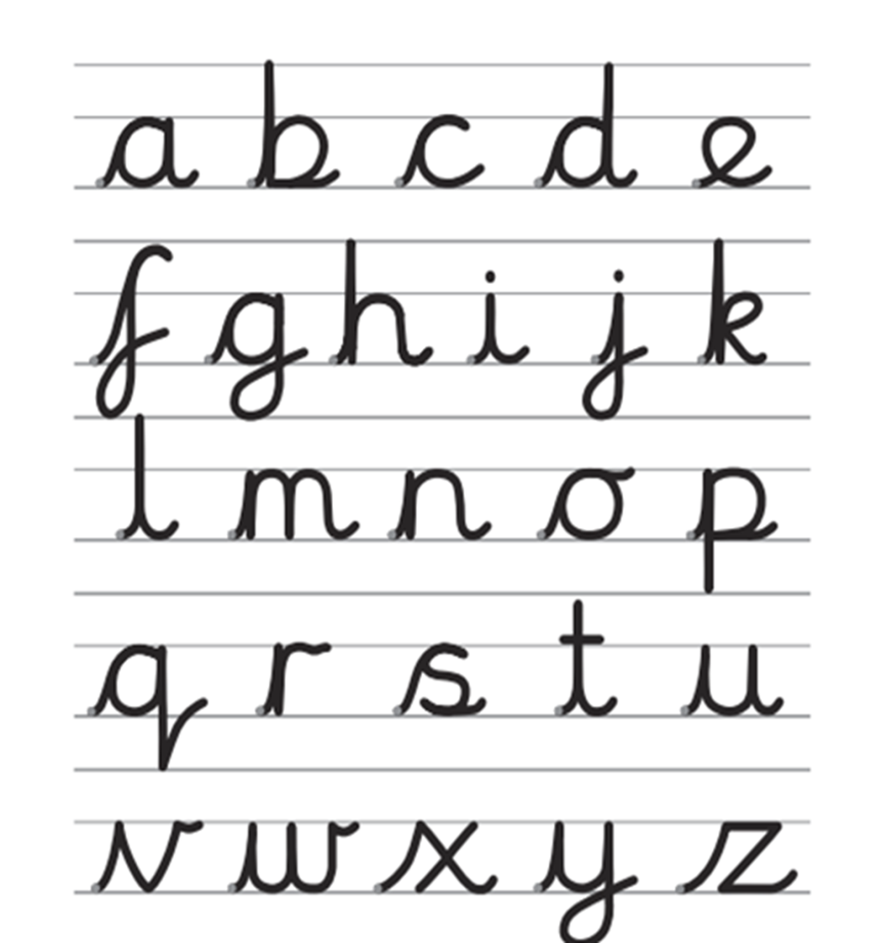
Supporting your child at home
Writing
All children in Key Stage 1 are encouraged to join their writing using this format:
The Letterjoin website can be accessed at home using individual logins.
Please ask if you are unsure on how to access this.
Notes:
Ria

Slide 15
Supporting your child at home
Reading
Please record each time you read with your child in their reading record.
When your child finishes their book, it is their responsibility to place it in the reading tray in their classroom.
Whilst reading together, please ask your child questions to check their understanding.
Notes:
Ria- predictions, main characters, sequences, comparing to other stories

Slide 16
Supporting your child at home
Maths
Number bonds to 10 then to 20 and the related subtraction facts.
Times tables and related division facts 10, 5 and 2.
Mental addition and subtraction.
Time.
Money.
Notes:
Emma – board games/ cards

Slide 17
Spellings
As in year one, we will send spellings home every Friday for the children to learn.
Children will be tested on these on the following Friday.
They may be a mixture of common exception words and also spelling patterns linked to their phonics.
It is important that you support your child to learn these at home and discuss the meaning of the words.

Slide 18
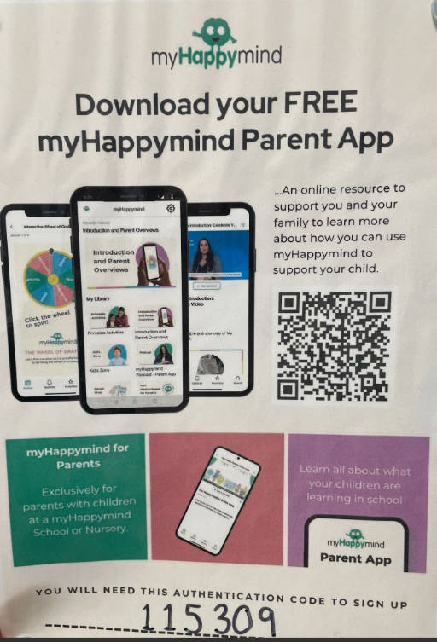
My Happy mind

Slide 19
Log ins
In your child’ reading record, you will find log ins for different learning tools:
Letter join (coming soon)
Times Table Rockstars (coming soon)
Phonics Bug digital books (coming soon)

Slide 20

Any questions?

